Slide 1
AUTOMATIC ATTENDANCE
SYSTEM USING FACE RECOGNITION
Group Members:
Akshay Mohan
Jidin K
Rohith K
Adithya P
Guide:
Ms. Savitha Gopal
Assistant Professor
Department of Information technology
Information technology

Slide 2
Contents
TOPICS | SLIDE NO:
Problem statement | 3
Motivation | 4
Objectives | 5
Requirement gathering & analysis | 11
SRS document | 14
Design | 15
Implementation | 21
Testing | 32
Future perspectives | 43
Conclussion | 44
Refferences | 45
Information technology

Slide 3
Problem Statement
Manual marking of the class attendance.
Manual marking is time consuming and difficult.
Converting attendance as digital copy is time consuming.
Information technology

Slide 4
Motivation
Minimized use of paper.
Automated attendance calculation.
Minimize manual works of the staff.
Maximum time utilization.
Information technology

Slide 5
Objectives
Developing a system that will mark the attendance of the students by image classification.
This will be created as a software.
Marks attendance and stores as csv file.
Easy to use.
Information technology

Slide 6
System Study
Existing system
Manual attendance:-
* Attendance are marked in papers.
*More time consuming.
*Converting to softcopies are time consuming.
RFID:-
*It is expensive
*Over head reading
*Some material may create signal problem
Information technology

Slide 7
Biometric authentication system:-
*it includes iris,fingerprint and voice recognition
*Not much accurate
*false rejection & false acceptance

Slide 8
Proposed Methodology :-
Overcomes the drawbacks of existing system.
Data can be maintained easily.
The system will save a lot of time and effort.
Manual work is comparatively lesser.
Less paper usage.
Information technology

Slide 9
Feasibility Study
Technical Feasibility :-
The hardware and software tools required are available in the system.
There are no technical risks involved.
Operational Feasibility :-
The developed system will be very efficient and will be used by the staff and students.
Information technology

Slide 10
Schedule Feasibility :-
The drawbacks of the existing system will be resolved in the given time constraint.
Economic Feasibility :-
Considerably low cost.
Information technology

Slide 11
Requirement Gathering and Analysis :
End-user Specification :-
Computer with basic requirements.
A working webcam.
Information technology

Slide 12
Software Specification :
Operating system : Windows 8 or above, Linux, Ubuntu..
Front-end : Python
Design tool : Tkinder
Information technology

Slide 13
Hardware Specification :-
Processor : Intel / AMD
RAM : Minimum 4 GB of free RAM
Hard disk : 2.5 GB and another 1 GB for caches
Information technology

Slide 14
SRS Document
It is a detailed description of a software system.
It describes how the system will be expected to perform.
Developed with its functional and non functional requirements.
Describes the features and behaviour of a system or software application.
Our software requirement specification document can be found here.
Information technology

Slide 15
Design
*This system is designed to reduce the flaws of existing system
*Reduces paper work
*Mark attendance effortlessly
Major modules in this application
*student registration
*face recognition
*view student attendance
Information technology

Slide 16
Modules description
Student registration:-
*Registration of students are carried out here
*All details are stored here and can be updated if it is required
Face recognition:-
*Student attendance is being taken using face recognition
View student attendance:-
*Attendance details of students can be viewed
*Attendance details can be downloaded
Information technology

Slide 17
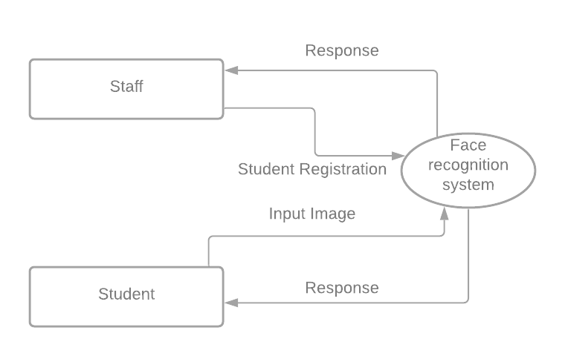
Data flow diagrams
Level 0
Information technology

Slide 18
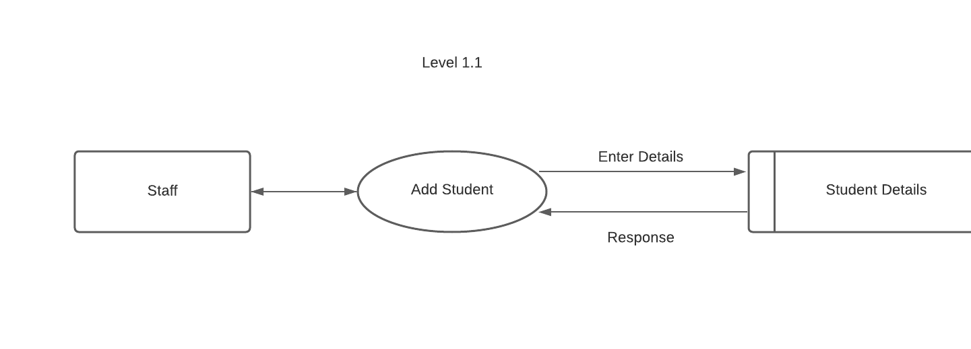
Level 1
Staff level
Information technology

Slide 19
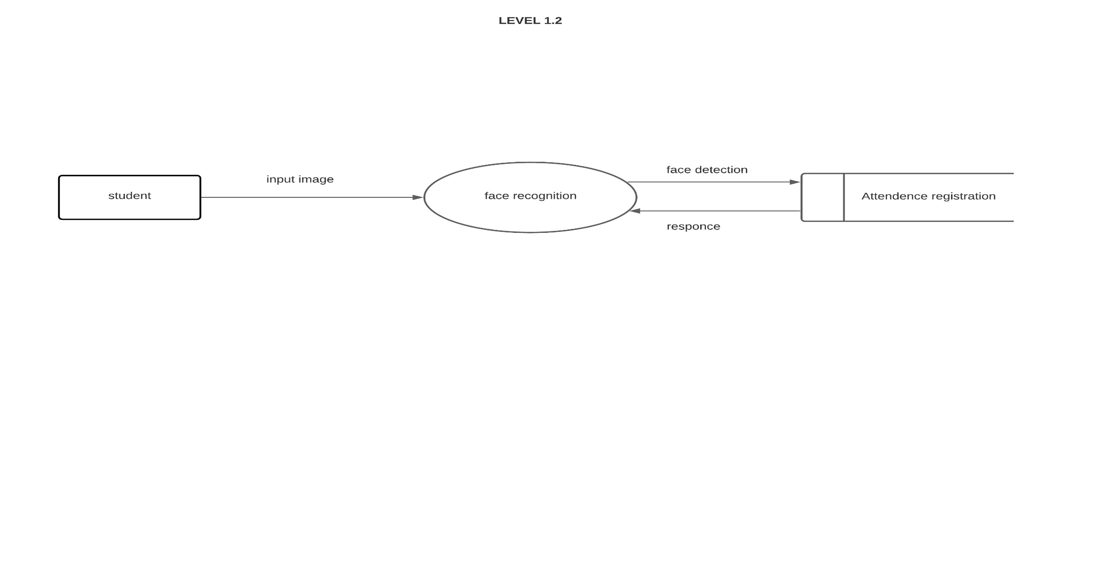
Student level
Information technology

Slide 20
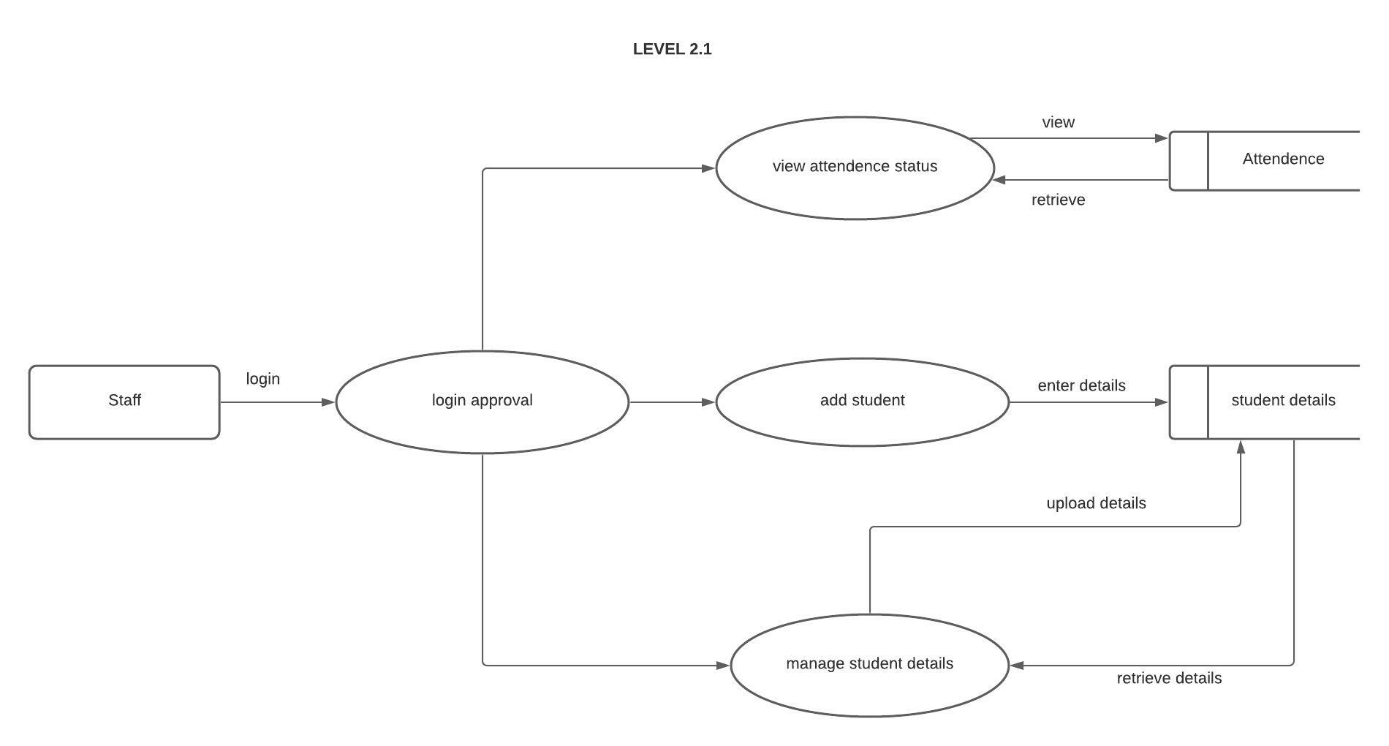
Level 2
Staff level
Information technology

Slide 21
Implementation
Processes
Users
Student registration
Staff
Student
Image capturing
Automatic attendance system
Information technology

Slide 22
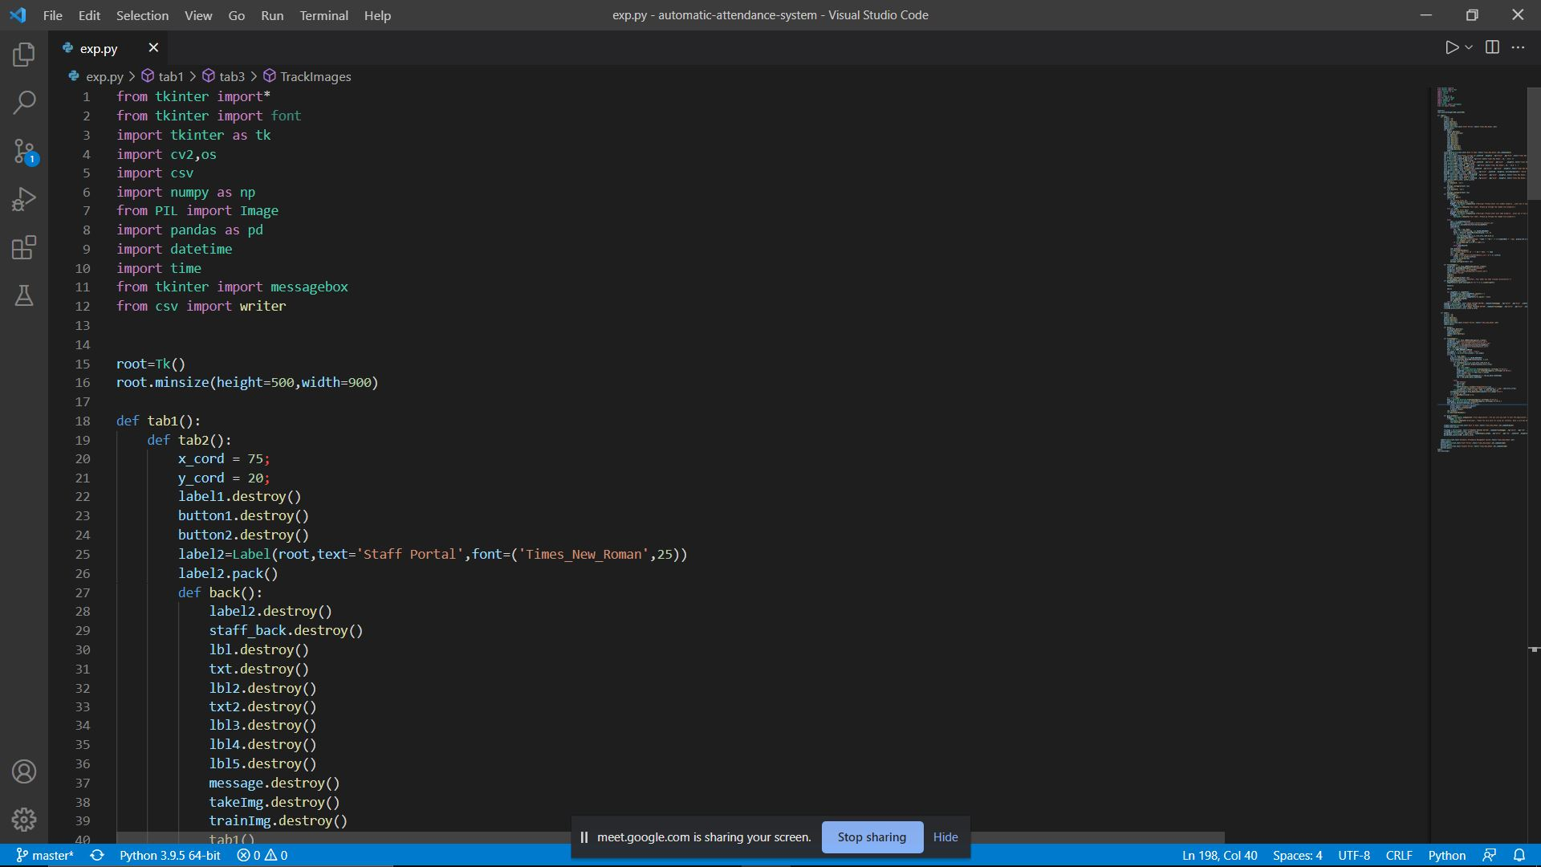
Information technology

Slide 23
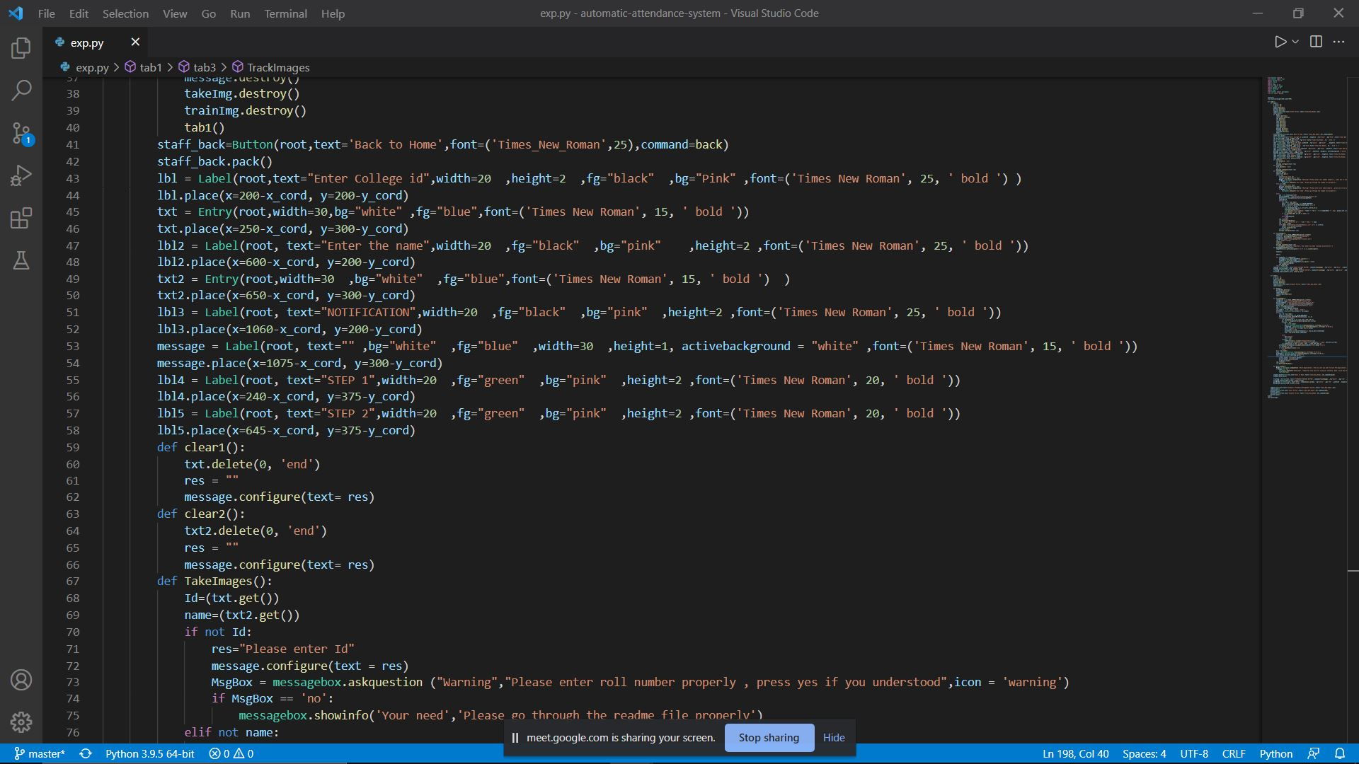
Information technology

Slide 24
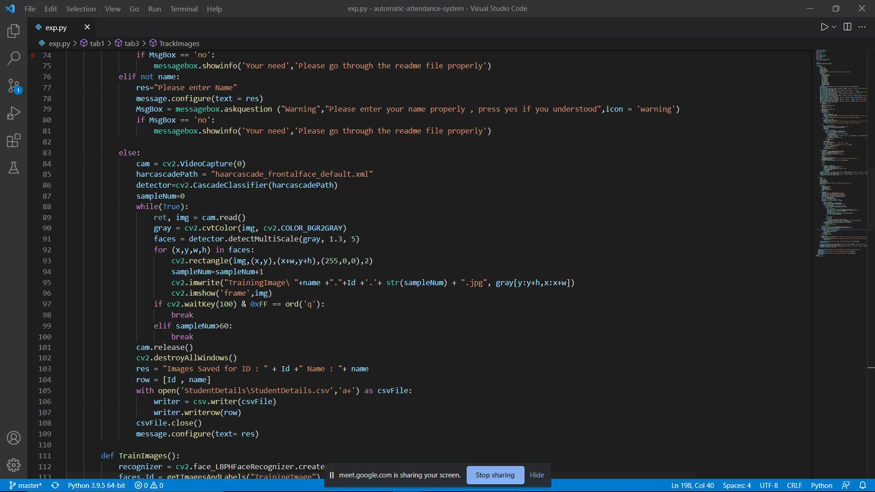
Information technology

Slide 25
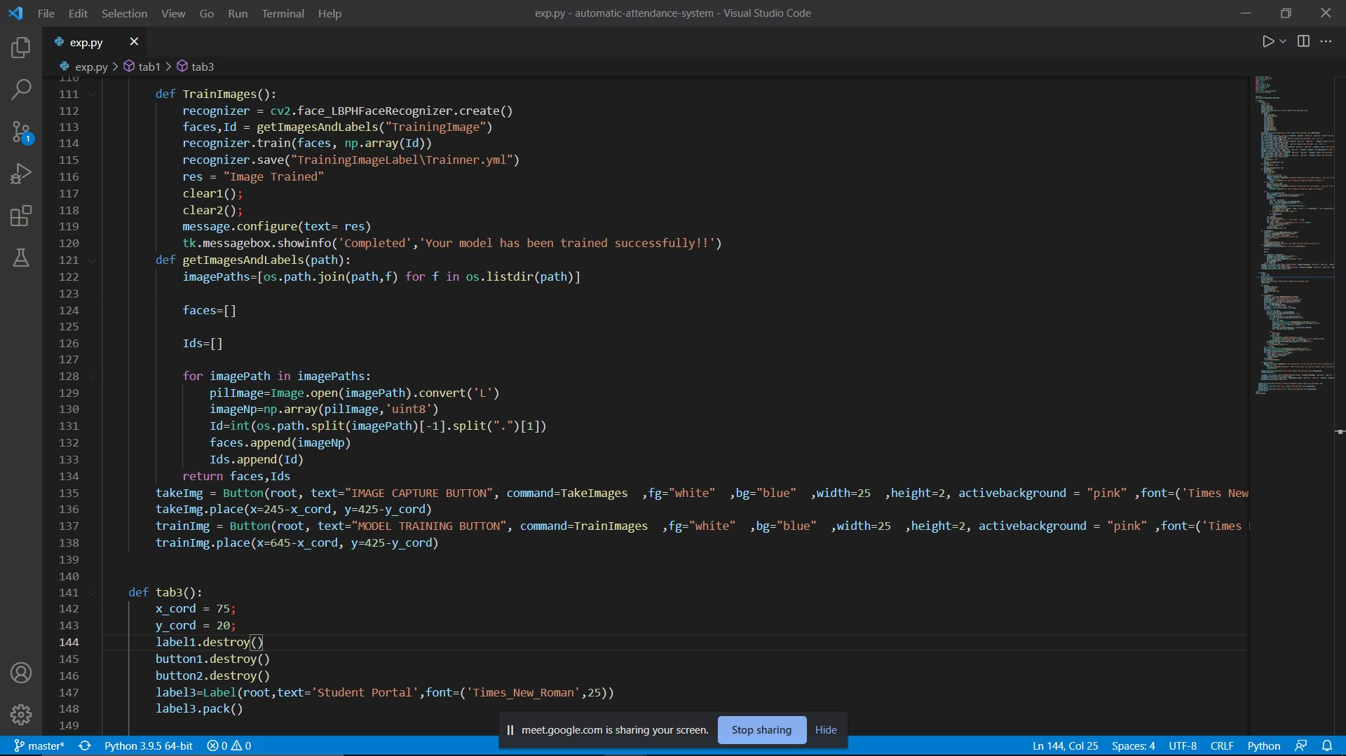
Information technology

Slide 26
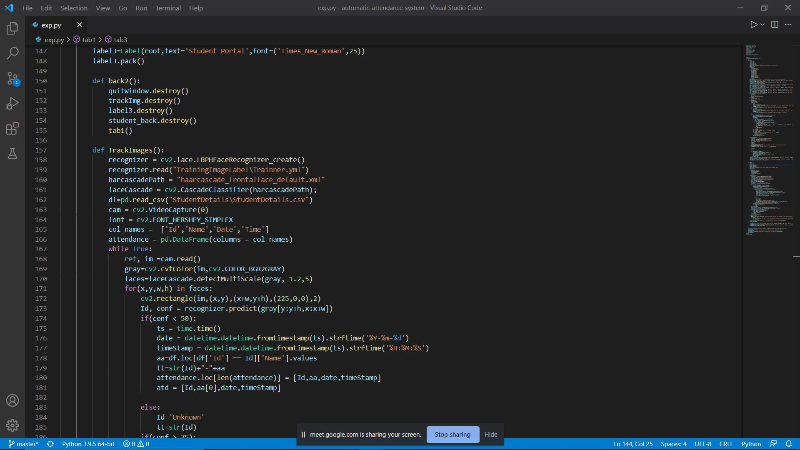
Information technology

Slide 27
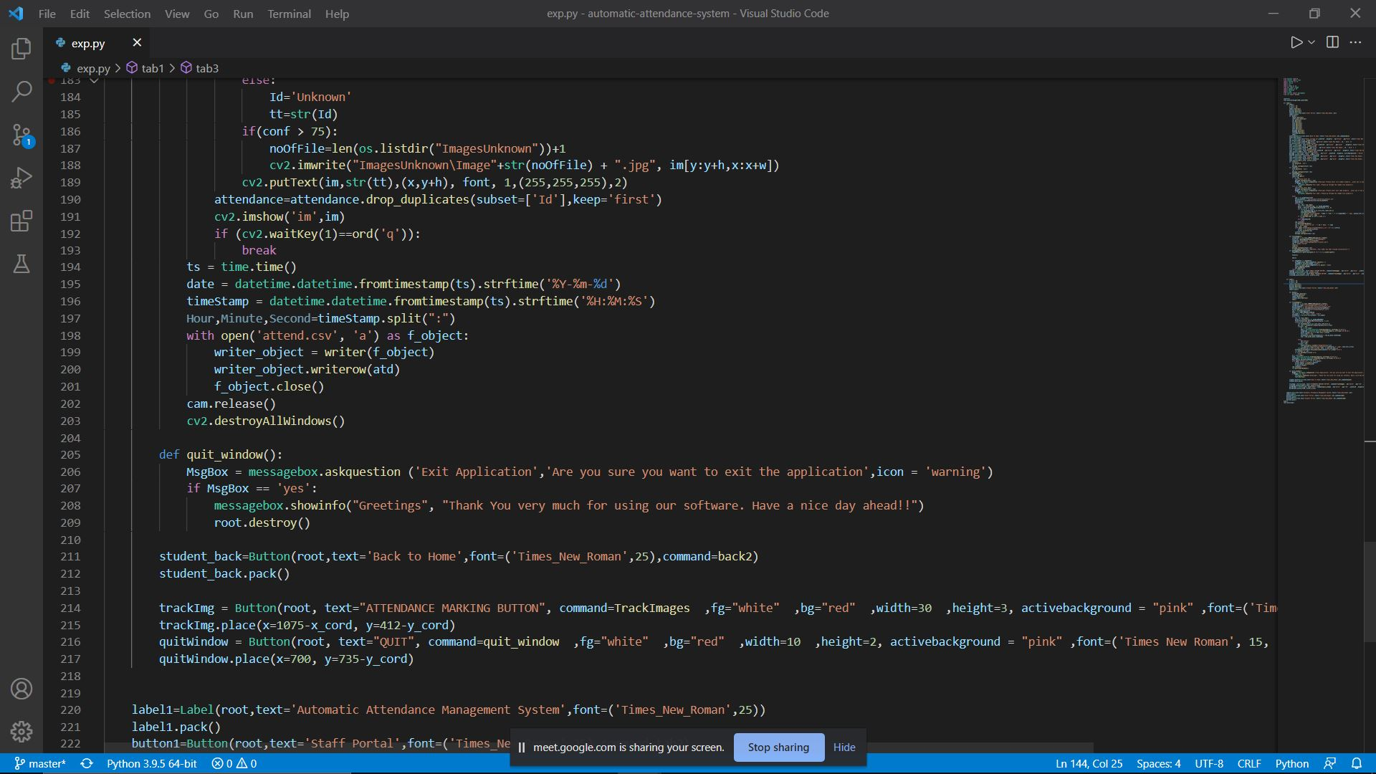
Information technology

Slide 28
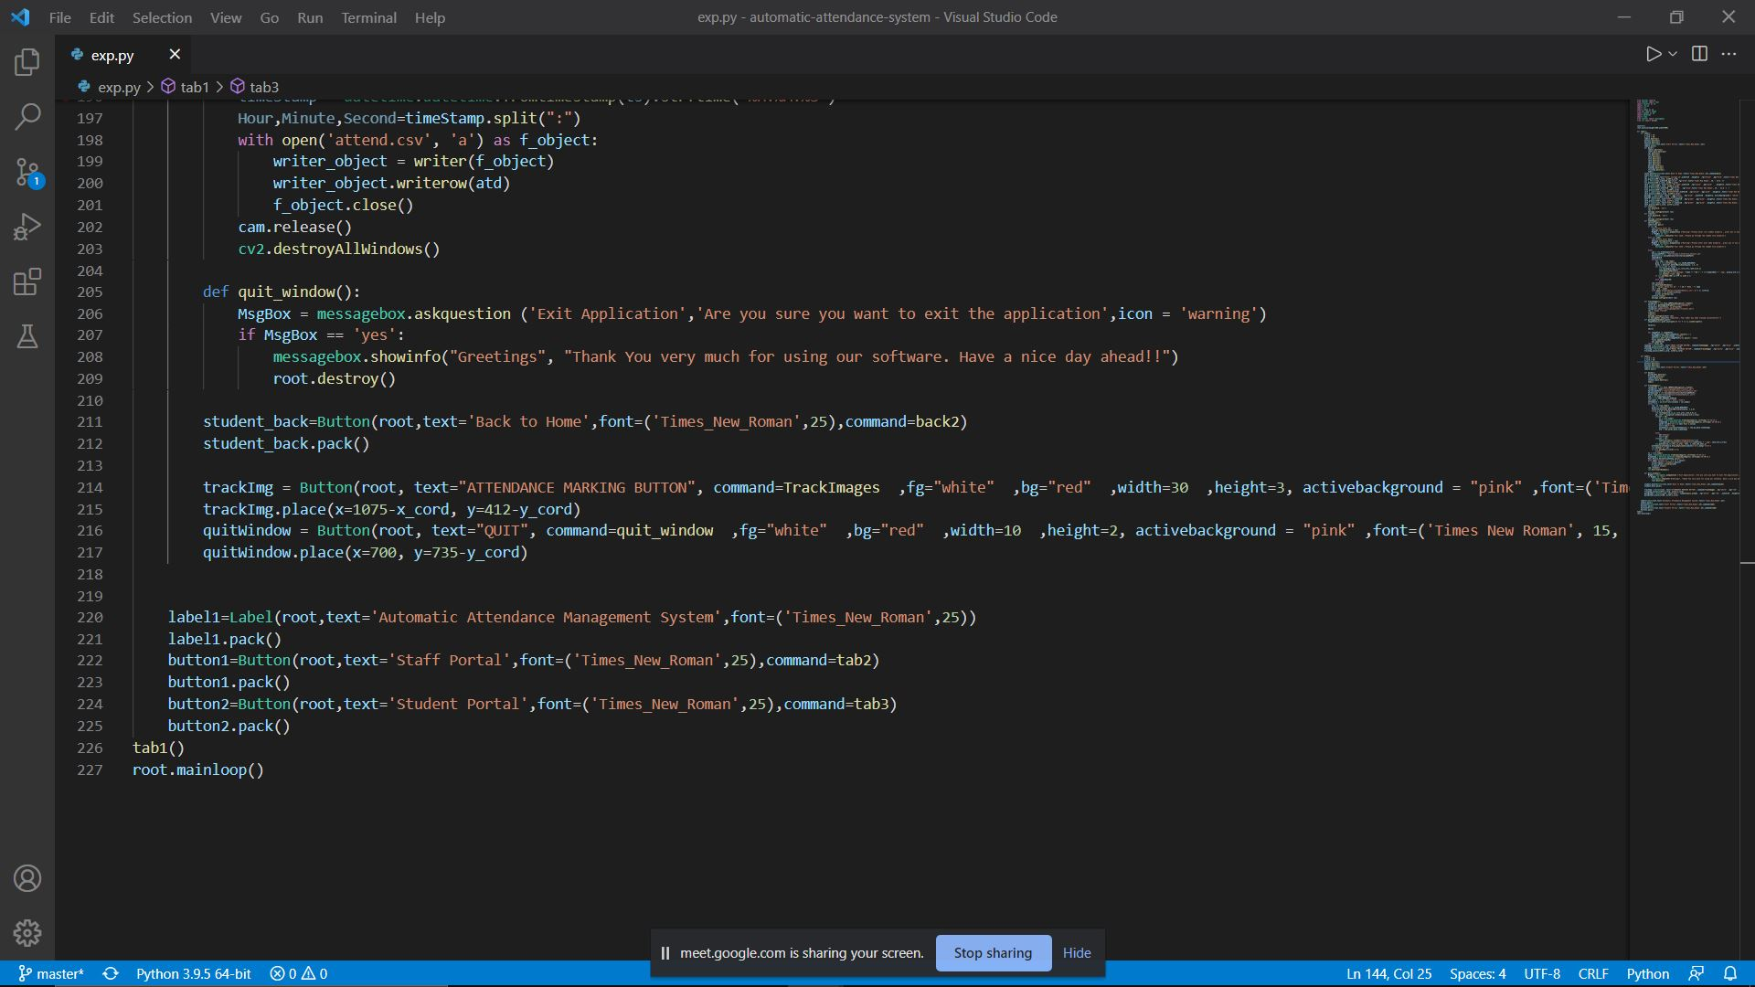
Information technology

Slide 29
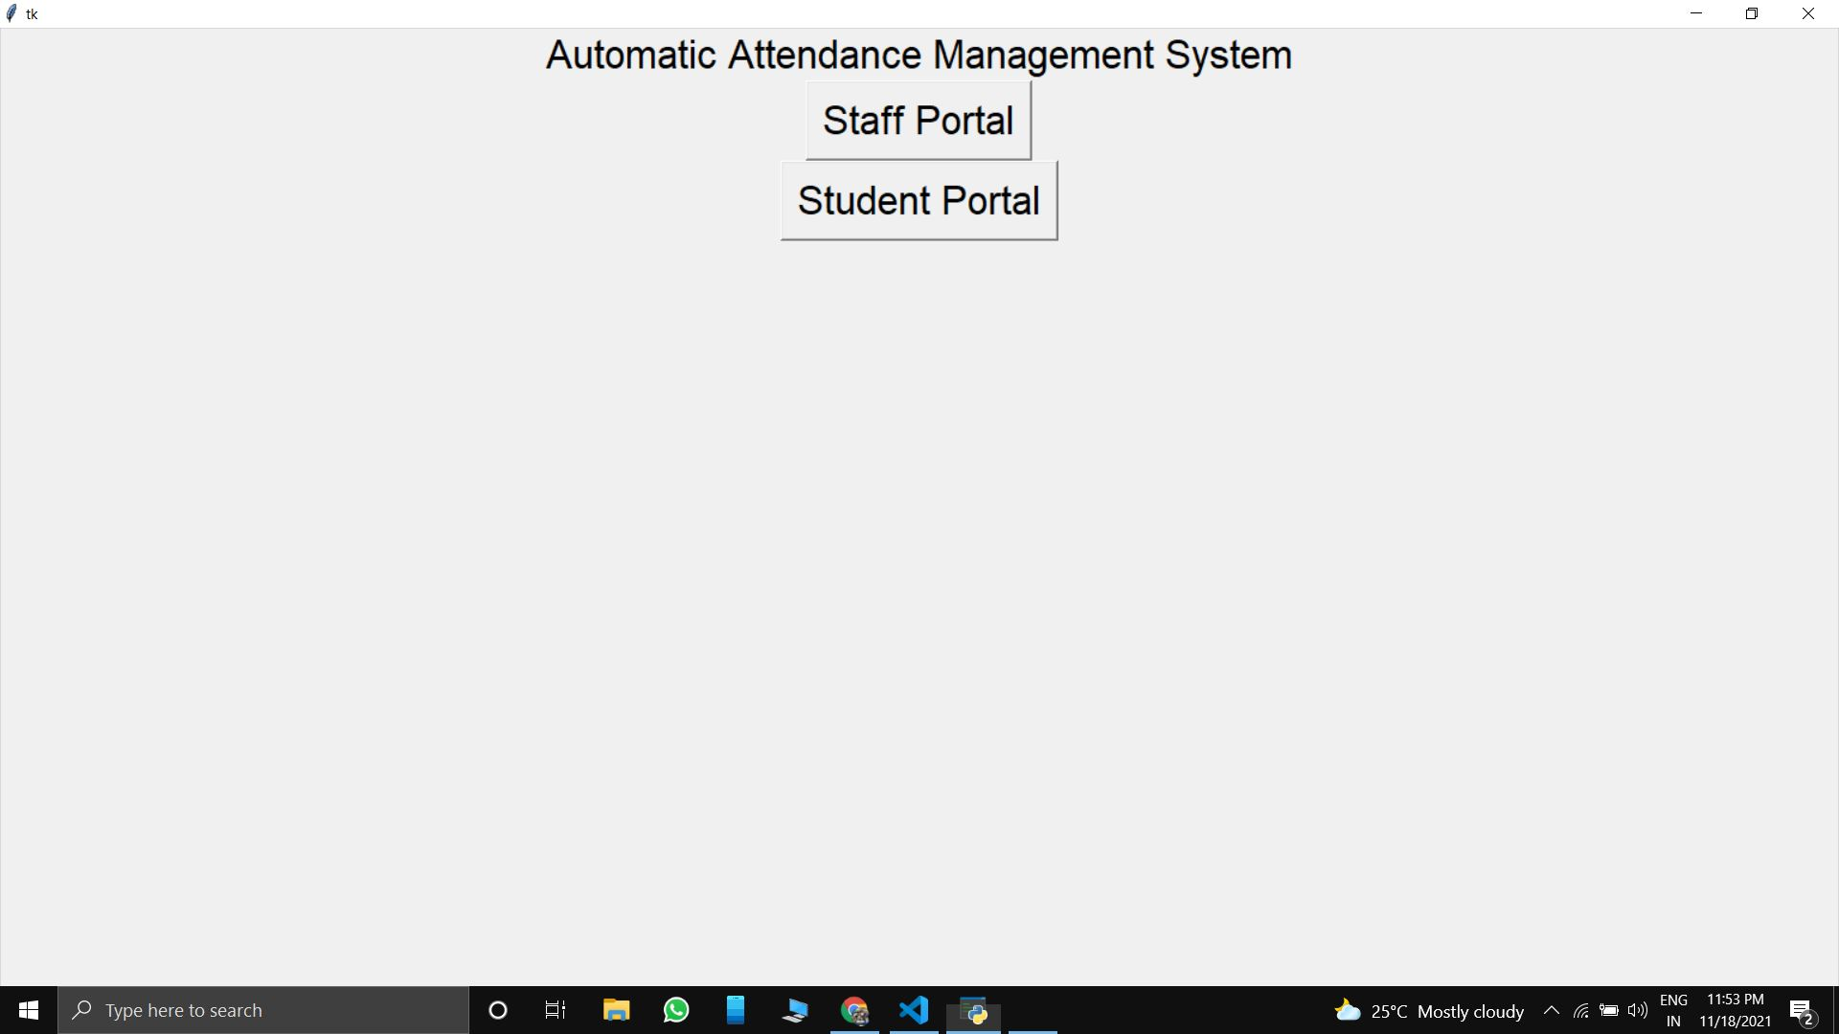
Screenshots
Home page
Information technology

Slide 30
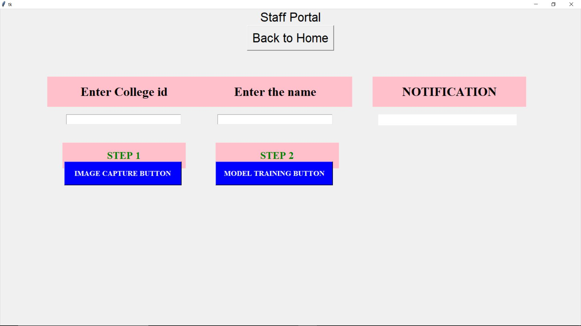
Staff portal
Information technology

Slide 31
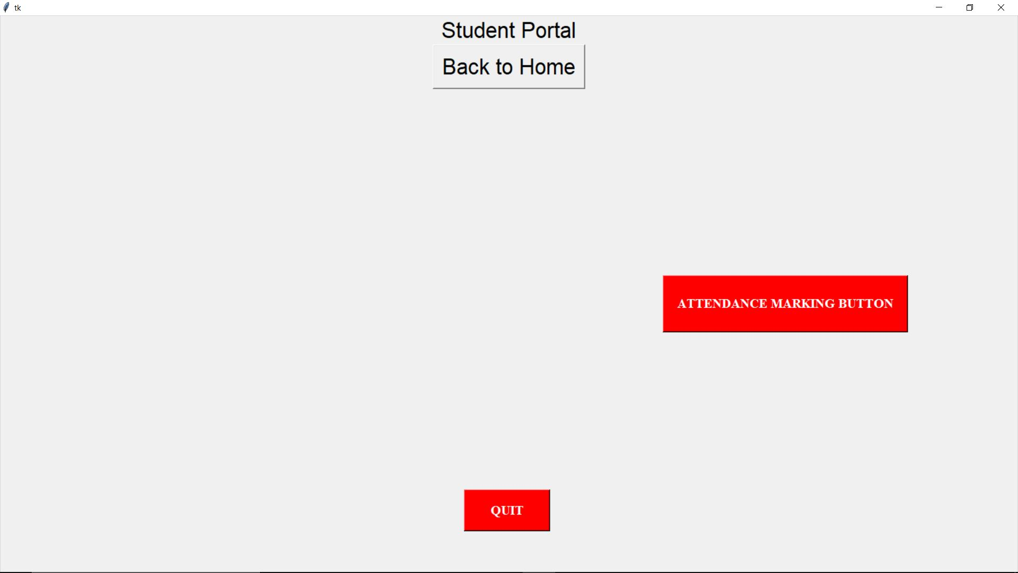
Student portal
Information technology

Slide 32
Testing
Unit Testing
77
• Individual units or components of a software are tested.
• It is done during coding phase of a project.
• Allows the programmer to refine code and make sure the
module works properly.
Inference : Each function/module has been tested
individually to success.
Information technology

Slide 33
Integration Testing
78
• Individual units or components are combined and tested as a
group.
• Purpose of the integration testing is to expose faults in the
interaction between integrated units.
• Once all the modules have been unit tested, integration testing is
performed.
Inference : The application works satisfactorily upon integration of
all modules as displayed in the Screenshots section.
Information technology

Slide 34
Validation Testing
•Validation testing ensure that the developed software
satisfies the client/user needs.
•The business requirement logic have to be tested in detail.
•All the critical functionalities must be tested here.
•Also known as dynamic testing, where we are ensuring
that "we have developed the product right."
Inference : The application has been developed as per the
requirements.
Information technology

Slide 35
Test case1
TITLE : | Student registration by face detection and storage in training set.
PREREQUISITE : | After user inputted information of the form,Face are detected from the captured image,cropped and stored in training set for student registration.
TEST ACTION: | 1.Start the application 2.click staff portal 3.Student registration 4.Fill registration form 5.Image capturing button 6.Click model training button
EXPECTED RESULT: | On clicking image capture button image is captured,this detected face is cropped and in training set,subfolder is created of that roll number which was inputted and within it captured image of student is stored of .jpeg format.
Information technology

Slide 36
Test case 2
TITLE : | Face recognition and generation of attendance in an excel sheet.
PREREQUISITE : | Faces within the testing set are recognised with the training set and accordingly entry is generated to excel sheet
TEST ACTION : | 1.Start application 2.Click student 3.Attendance registration
EXPECTED RESULT: | Faces are recognized if matched entry is made in excel sheet of that particular roll number as present if not attendance is not marked.
Information technology

Slide 37
Test report
Test case 1
ITERATION | EXPECTED RESULT | ACTUAL RESULT | STATUS
1. | After filling the form,On clicking image capturing button an image is captured | After filling the form,On clicking image capturing button an image is captured | pass
2. | After image captured,On clicking model training button pop up notification that ‘your model has been trained successfully | After image captured,On clicking model training button pop up notification that ‘your model has been trained successfully | pass
Information technology

Slide 38
Test case2
ITERATION | EXPECTED RESULT | ACTUAL RESULT | STATUS
1. | Faces are recognized,if matched entry is made in excel sheet of the particular roll number as present.If not it does not mark attendance. | Faces are recognized,if matched entry is made in excel sheet of the particular roll number as present.If not it does not mark attendance. | pass
Information technology

Slide 39

Test case snapshots
Image and details of a student is saved in dataset for training
Information technology

Slide 40
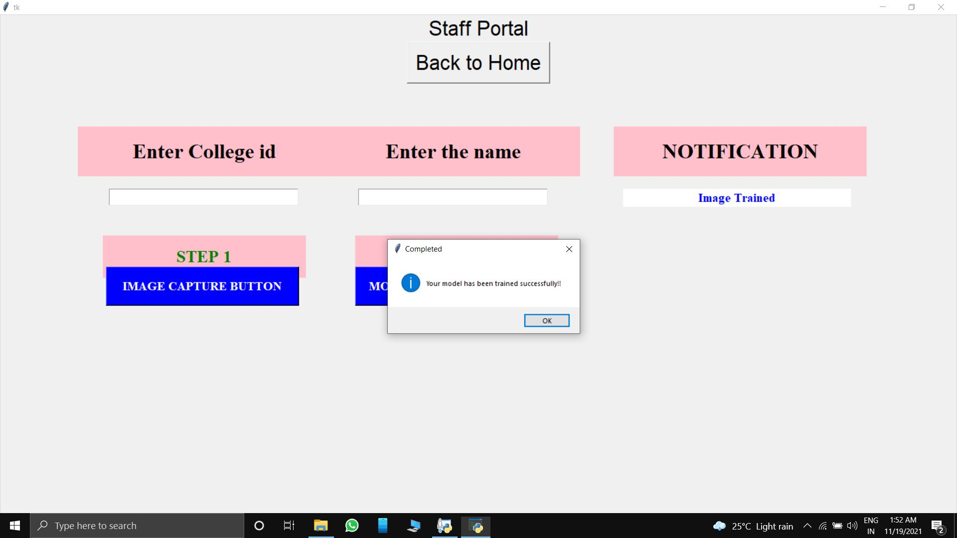
Student model is trained successfully
Information technology

Slide 41
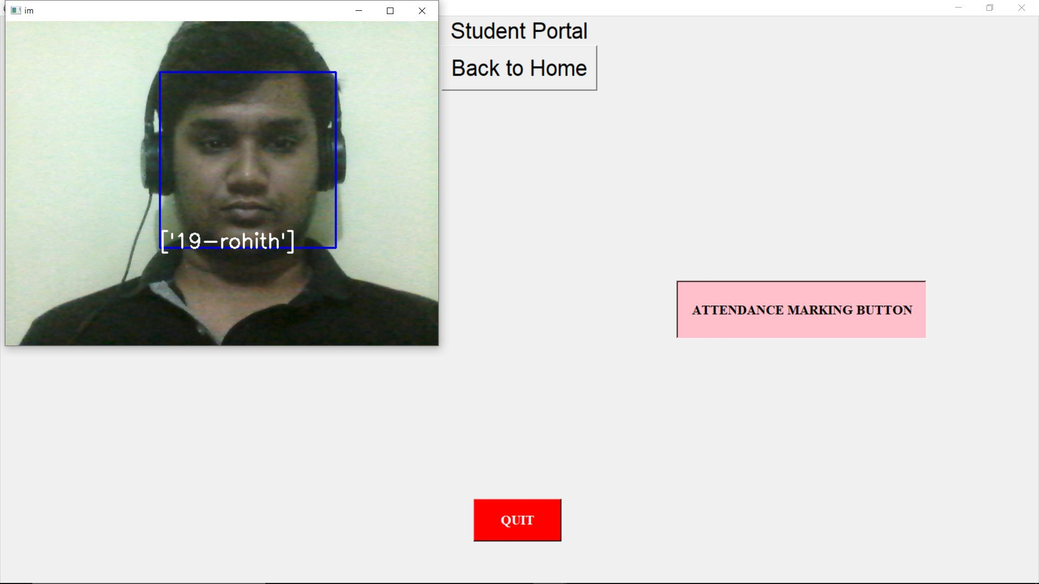
Face recognised and attendance marked for a student
Information technology

Slide 42
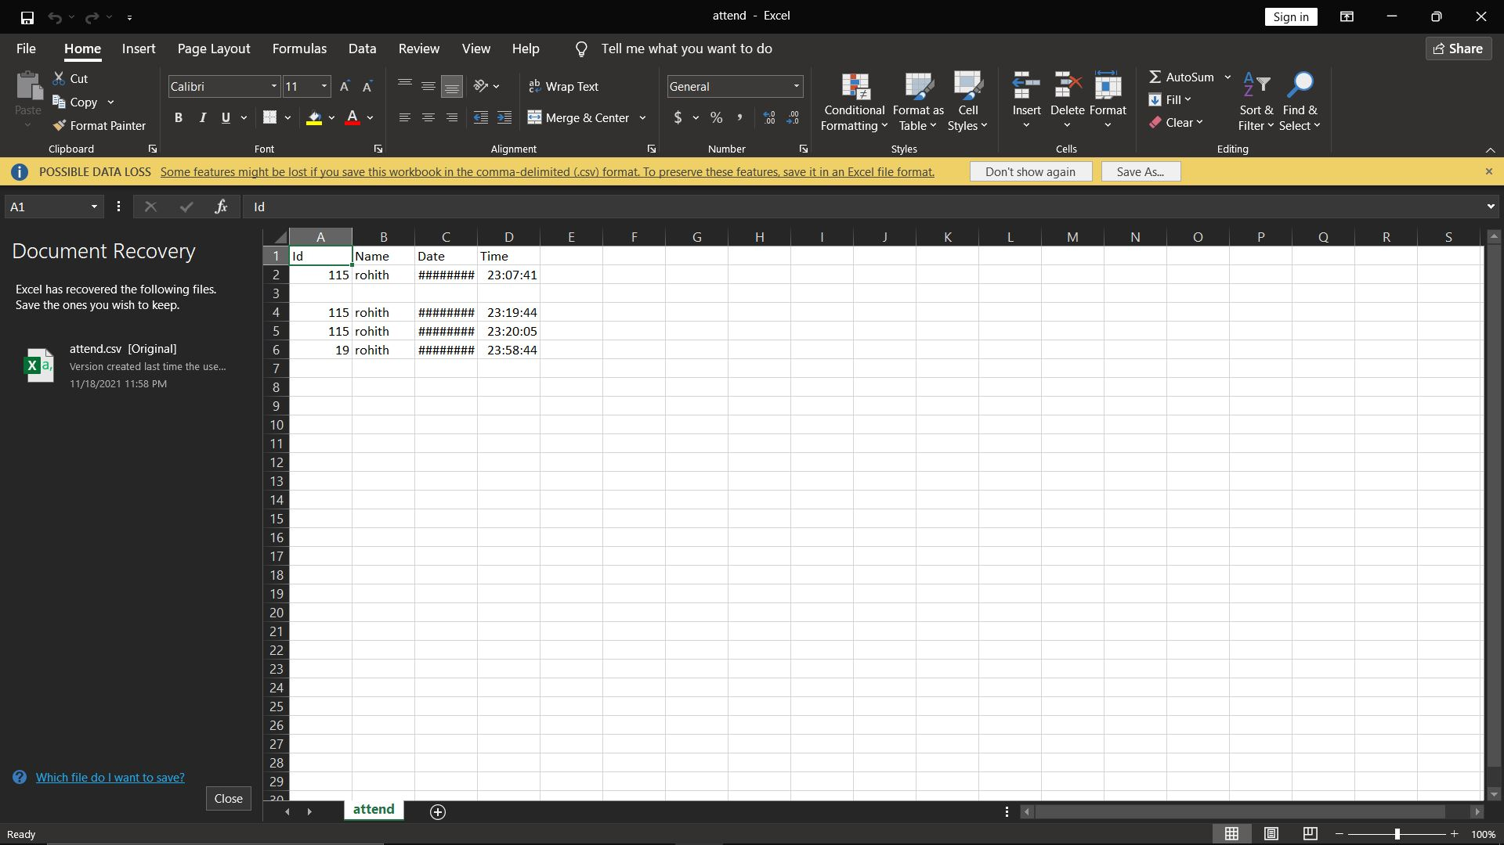
Attendance sheet for viewing attendance
Information technology

Slide 43
Future perspectives
Our Automatic attendance system can be extended to more number of students with freedom to change list of students according to class changes.The system can be made more flexible to allow updating of templates in case student incurs significant amount of change in his facial features.The system can also be extended to allow better face recognition algorithm in which even rotational features of face can be detected efficiently.Further work can be done on this project to alert the student by sending SMS regarding the attendance.SMS alert can be given to the parent of the student.
Information technology

Slide 44
Conclusion
Before the development of this project. There are many loopholes in the process of taking attendance using the old method which caused many troubles to most of the institutions. Therefore, the facial recognition feature embedded in the attendance monitoring system can not only ensure attendance to be taken accurately and also eliminated the flaws in the previous system. By using technology to conquer the defects cannot merely save resources but also reduces human intervention in the whole process by handling all the complicated task to the machine.Capturing the images from camera or cc camera and applying techniques face detection and recognition can decrease the manual work from human and increase the security safety, taking the decision from this recognition result.We used Haar Cascade algorithm for image classification.We only needed basic software requirements for making this application.The face recognition system is working well. This attendance system shows the use of facial recognition techniques for the purpose of student attendance and for the further process this record of student can be used in exam related issues.
Information technology

Slide 45
References
[1] R. Hartanto and M. N. Adji, "Face Recognition for Attendance System Detection," 2018 10th International Conference on Information Technology and Electrical Engineering (ICITEE), 2018, pp. 376-381, doi: 10.1109/ICITEED.2018.8534942.
[2] Z. Cao, Q. Yin, X. Tang and J. Sun, "Face recognition with learning-based descriptor," 2010 IEEE Computer Society Conference on Computer Vision and Pattern Recognition, 2010, pp. 2707-2714, doi: 10.1109/CVPR.2010.5539992.
[3] P. Viola and M. Jones, "Rapid object detection using a boosted cascade of simple features," Proceedings of the 2001 IEEE Computer Society Conference on Computer Vision and Pattern Recognition. CVPR 2001, 2001, pp. I-I, doi: 10.1109/CVPR.2001.990517.
Information technology

Slide 46
THANK YOU
Information technology

